Slide 1
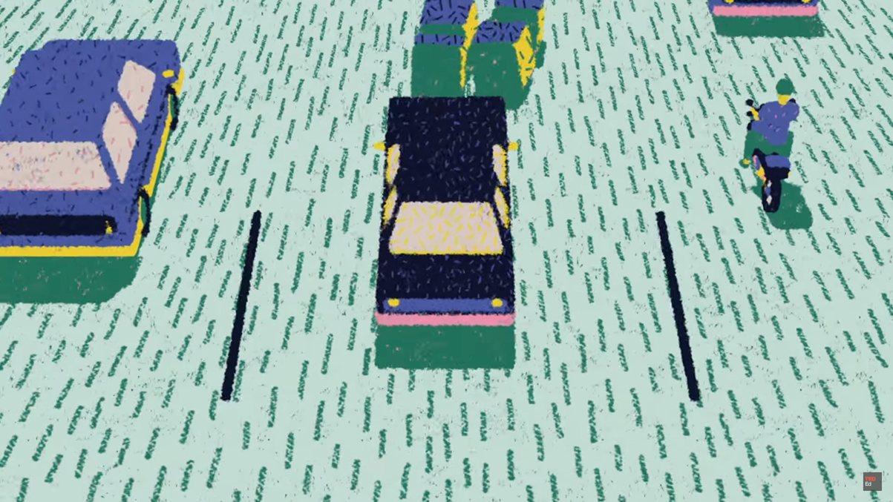

Slide 2
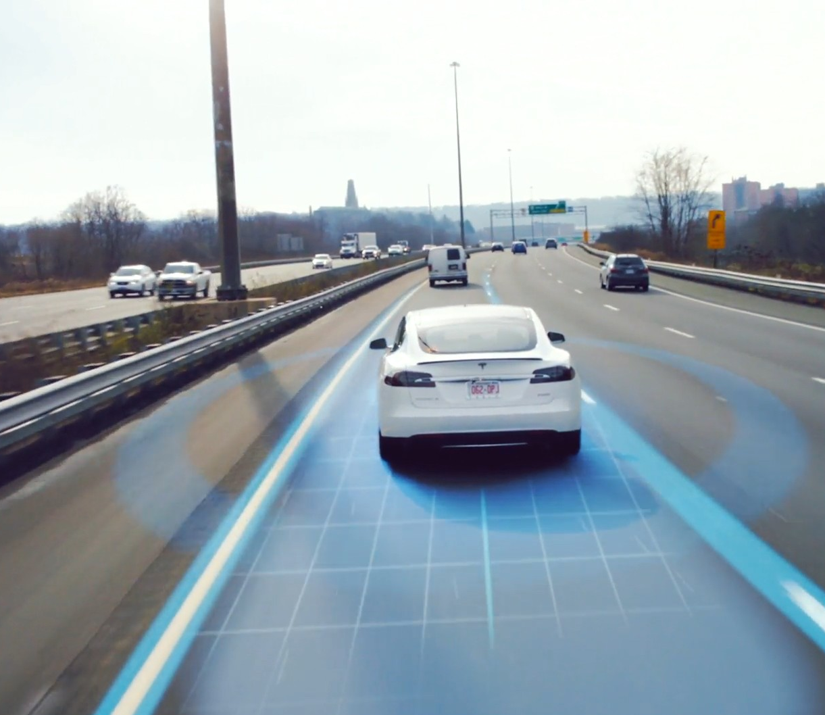
Self-driving cars
Presented by Joachim Veulemans

Slide 3

Definition
LEVEL 5
LEVEL 4
LEVEL 3
LEVEL 2
LEVEL 1
LEVEL 0

Slide 4
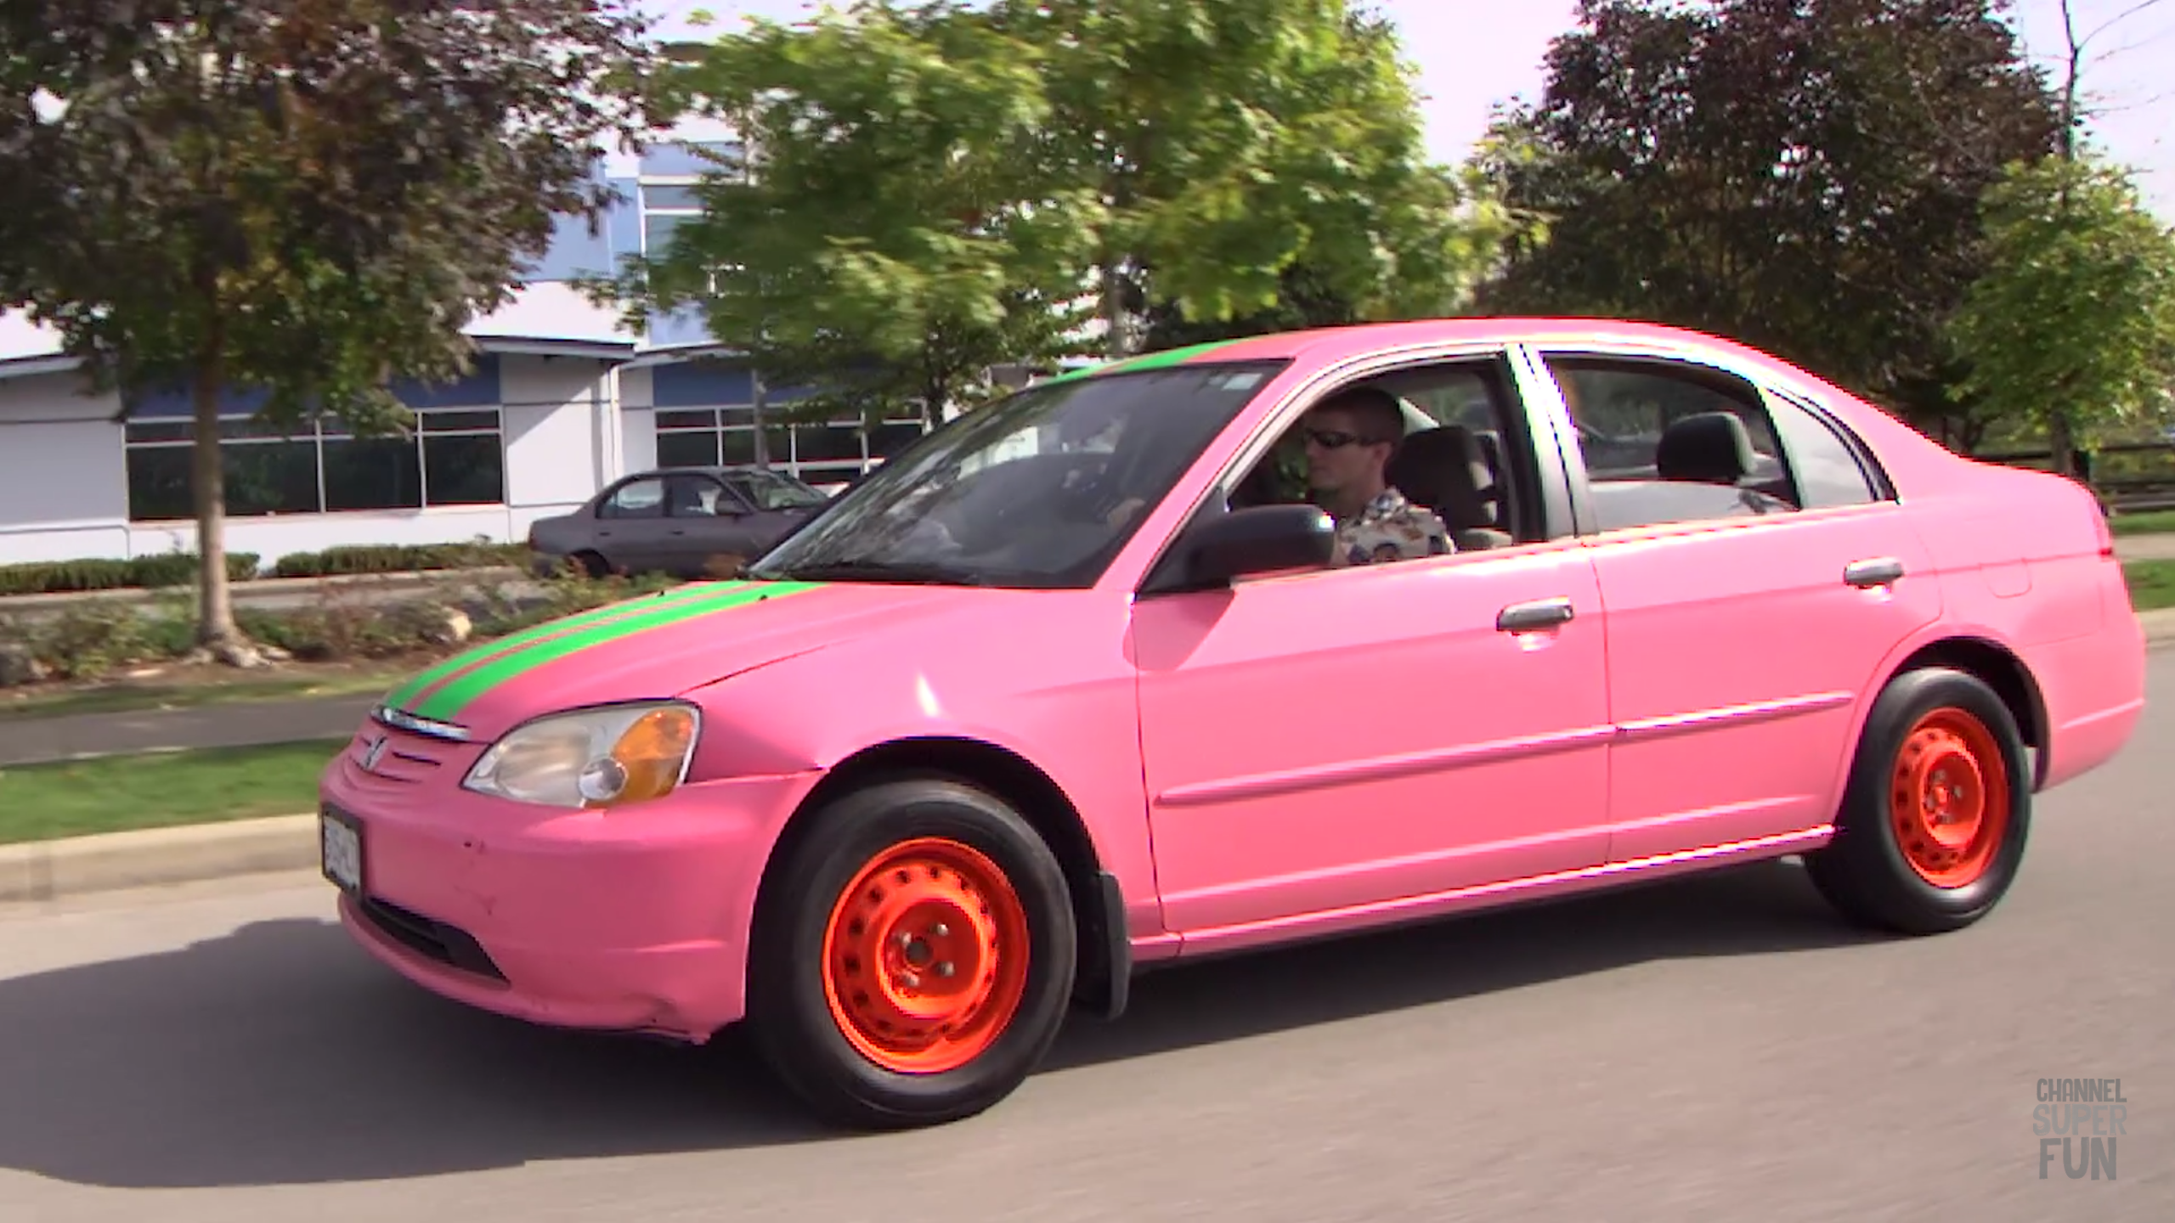
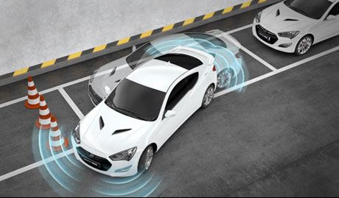
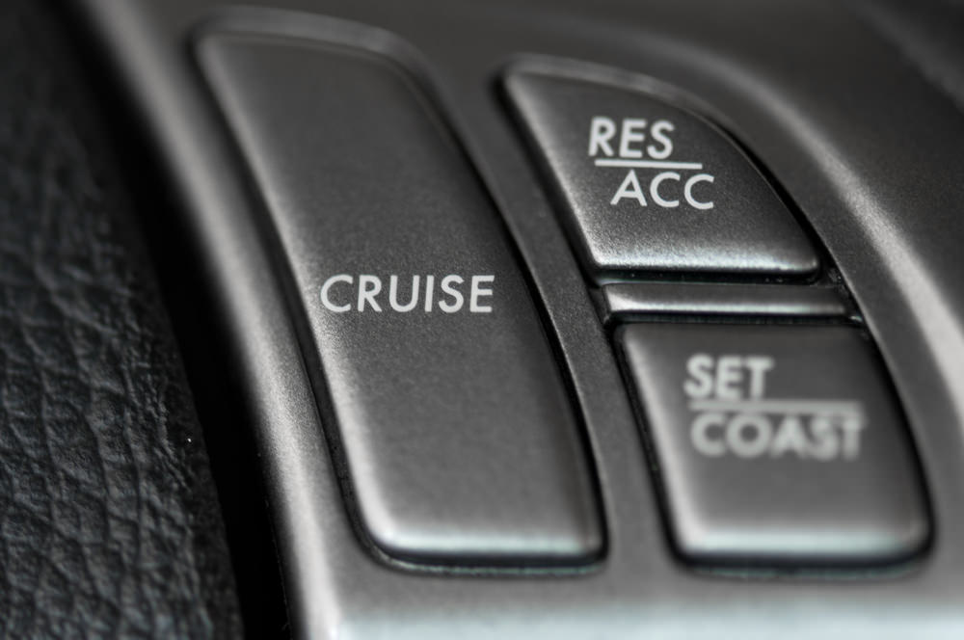
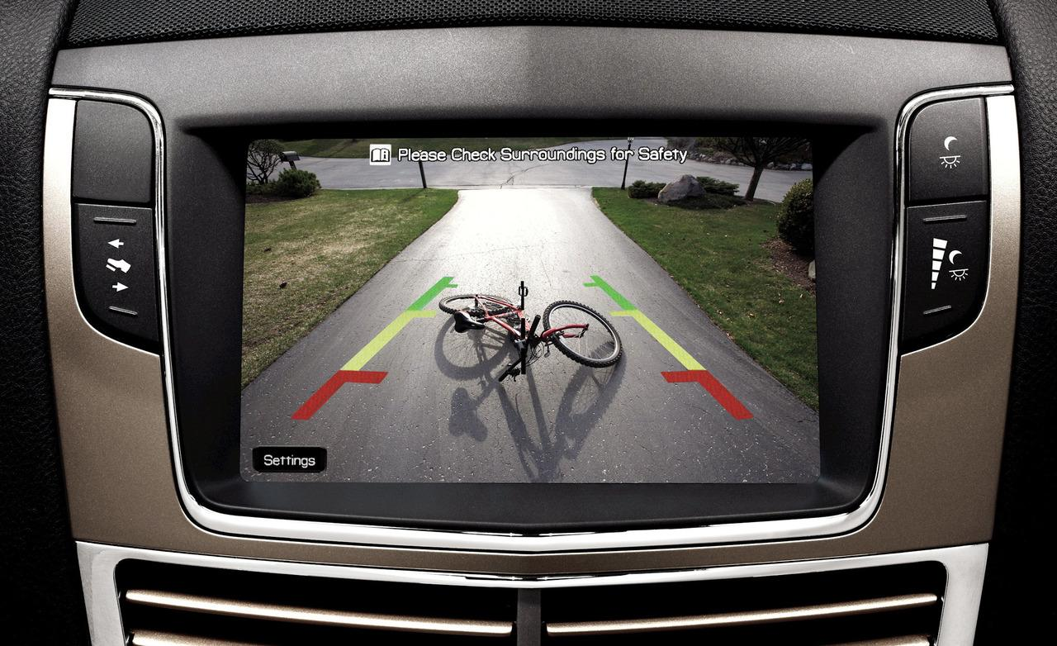
Level 0
LEVEL 5
LEVEL 4
LEVEL 3
LEVEL 2
LEVEL 1
LEVEL 0

Slide 5
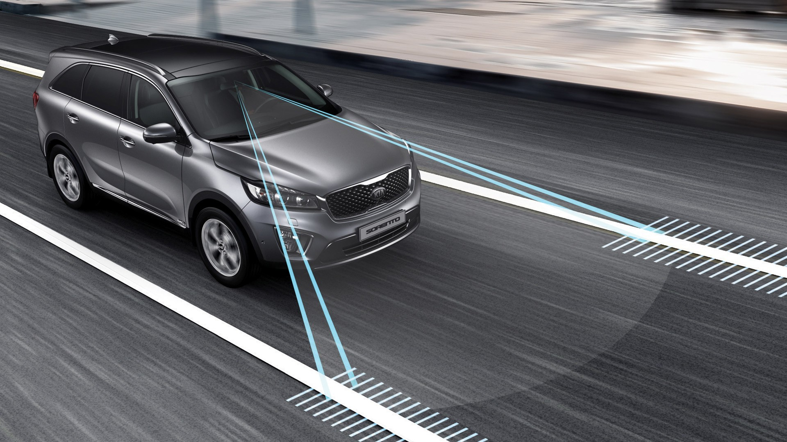
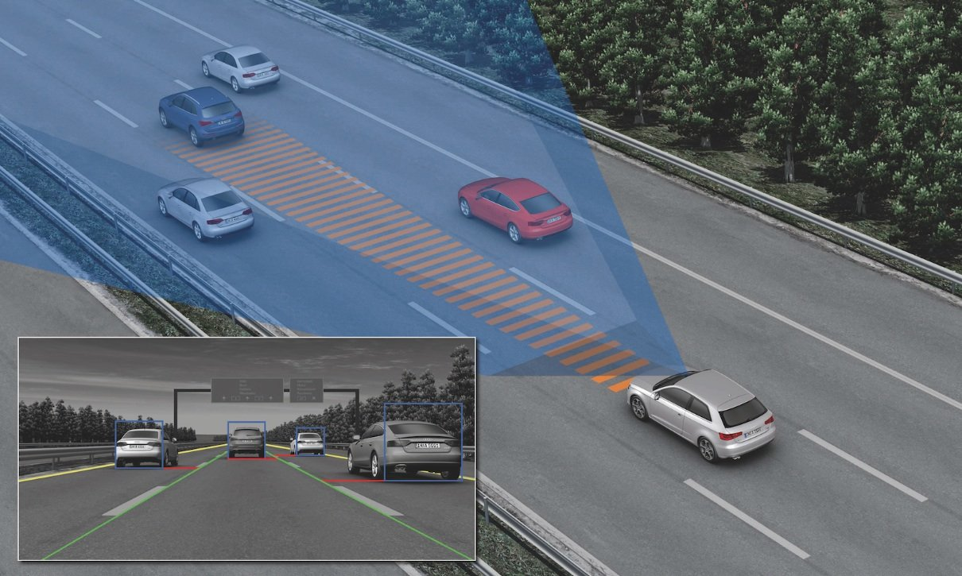
Level 1
Radar control assistance
LEVEL 5
LEVEL 4
LEVEL 3
LEVEL 2
LEVEL 1
LEVEL 0
Lane assist

Slide 6
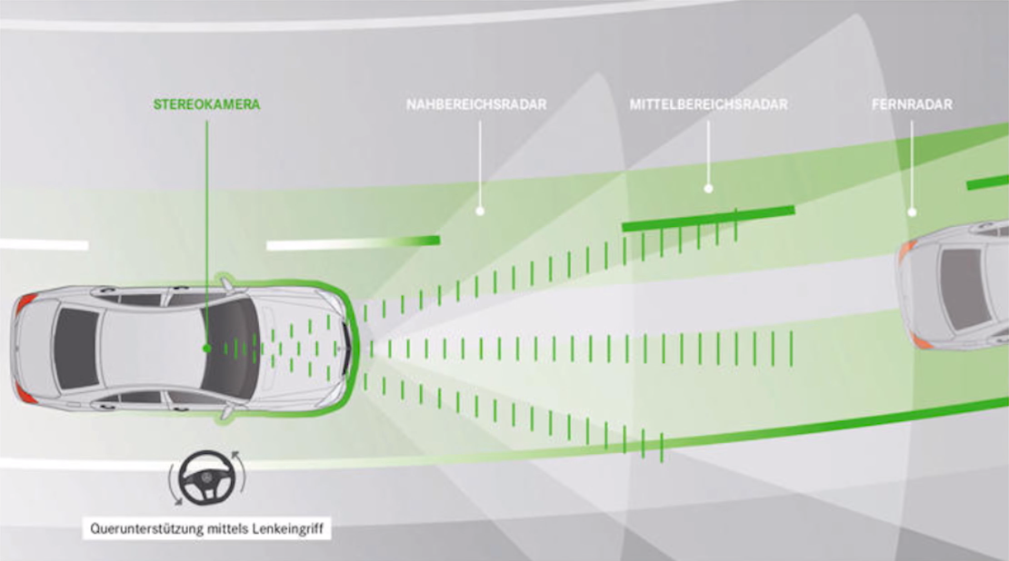
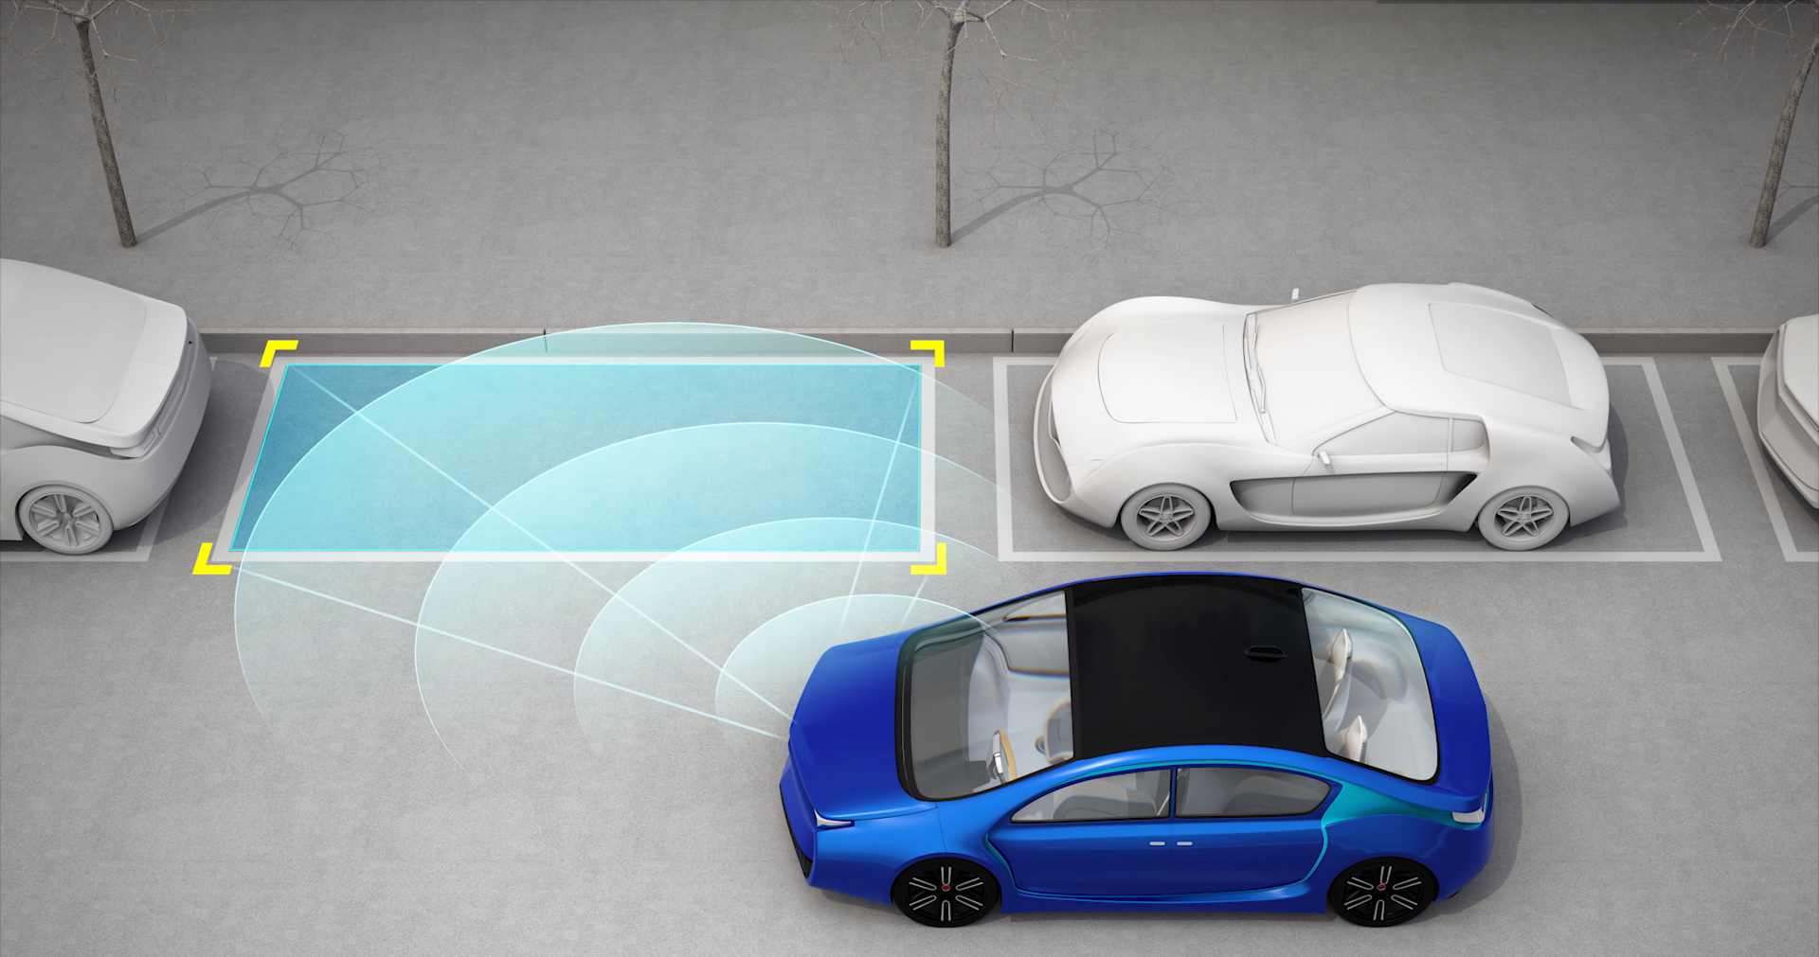
Level 2
Small easy manoeuvres
LEVEL 5
LEVEL 4
LEVEL 3
LEVEL 2
LEVEL 1
LEVEL 0

Slide 7
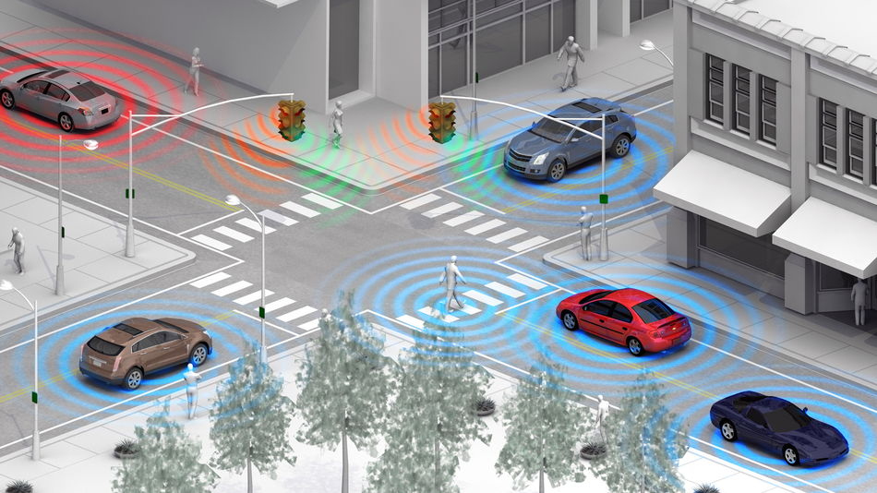
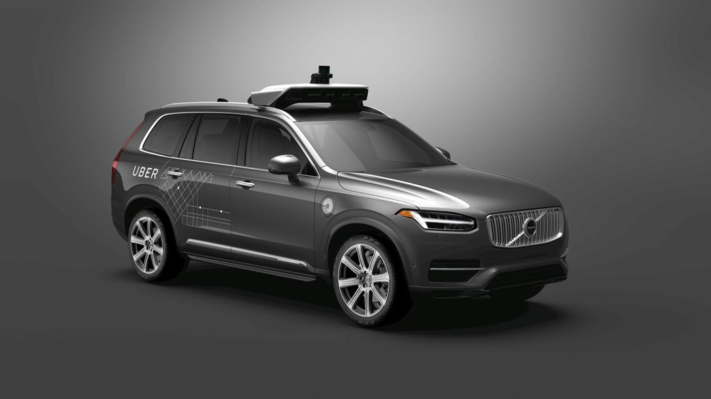
Level 3
Human must pay attention
LEVEL 5
LEVEL 4
LEVEL 3
LEVEL 2
LEVEL 1
LEVEL 0
Human must interact when needed

Slide 8
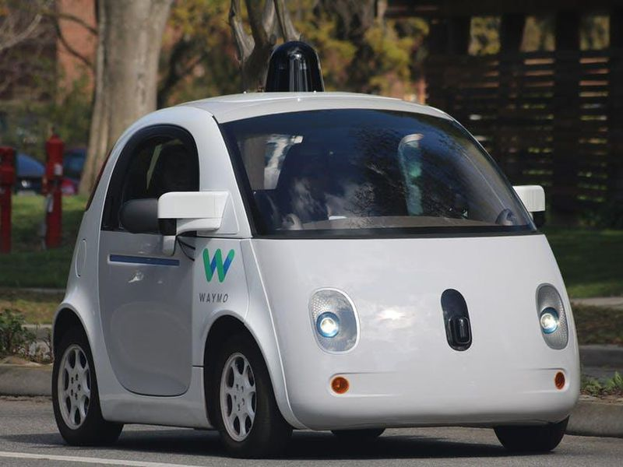
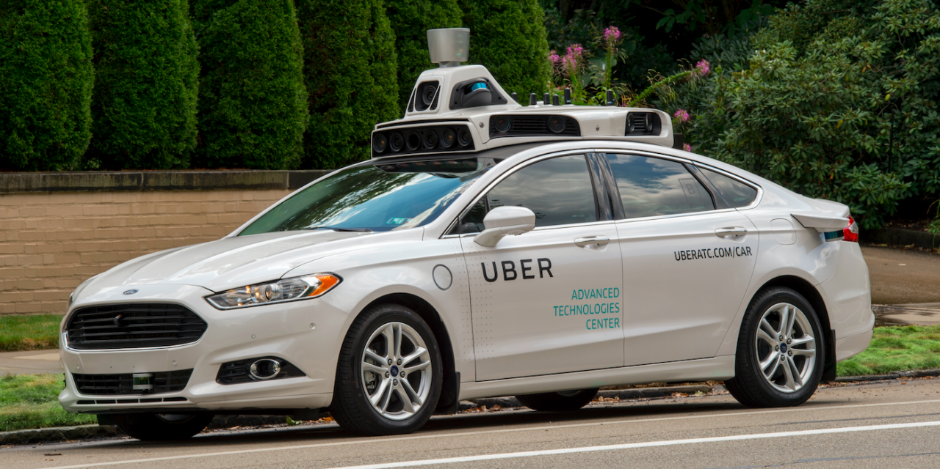
Level 4
Human must NOT pay attention
LEVEL 5
LEVEL 4
LEVEL 3
LEVEL 2
LEVEL 1
LEVEL 0
Human interaction only in serious complex situations

Slide 9
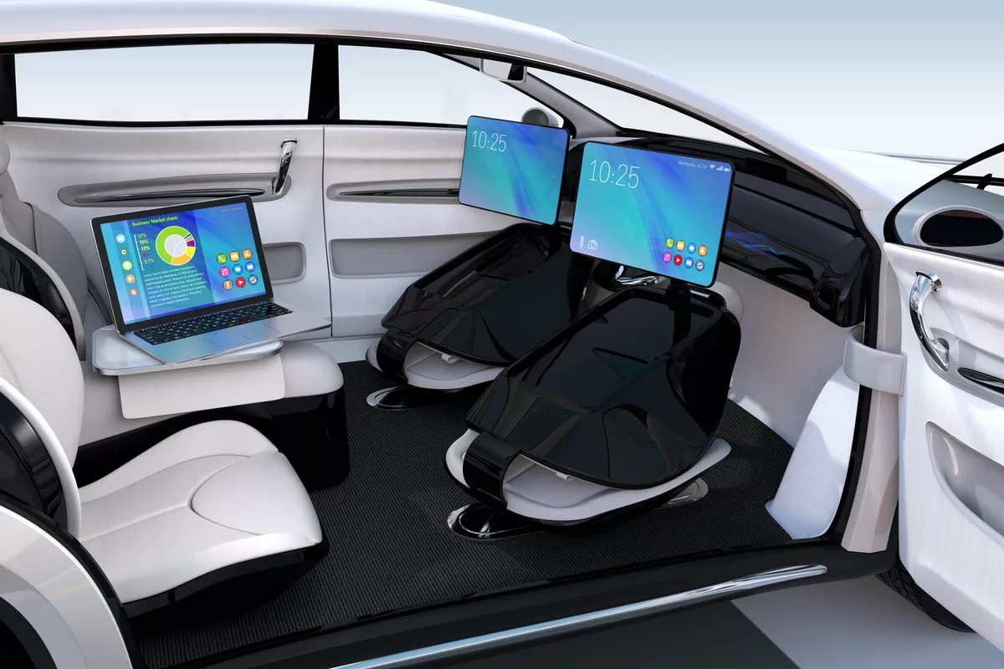
Level 5
LEVEL 5
LEVEL 4
LEVEL 3
LEVEL 2
LEVEL 1
LEVEL 0
Human interaction prohibited

Slide 10
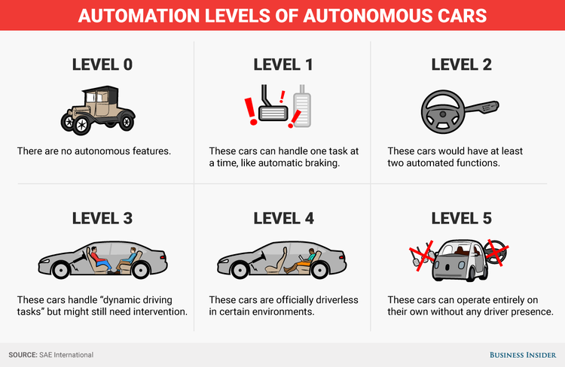
Summary

Slide 11
What now?
+ Much safer
+ Less traffic jams and smoother flow of traffic
+ You can drink and drive!
- Car can be hacked
- Car decides about your life
- Car decides about the fate of other people

Slide 12
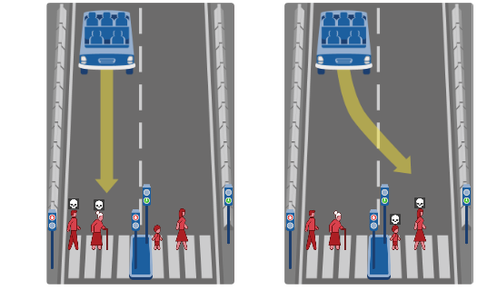
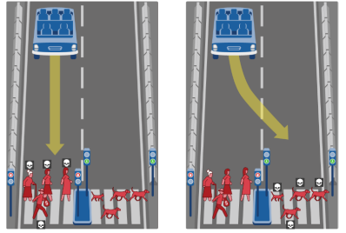
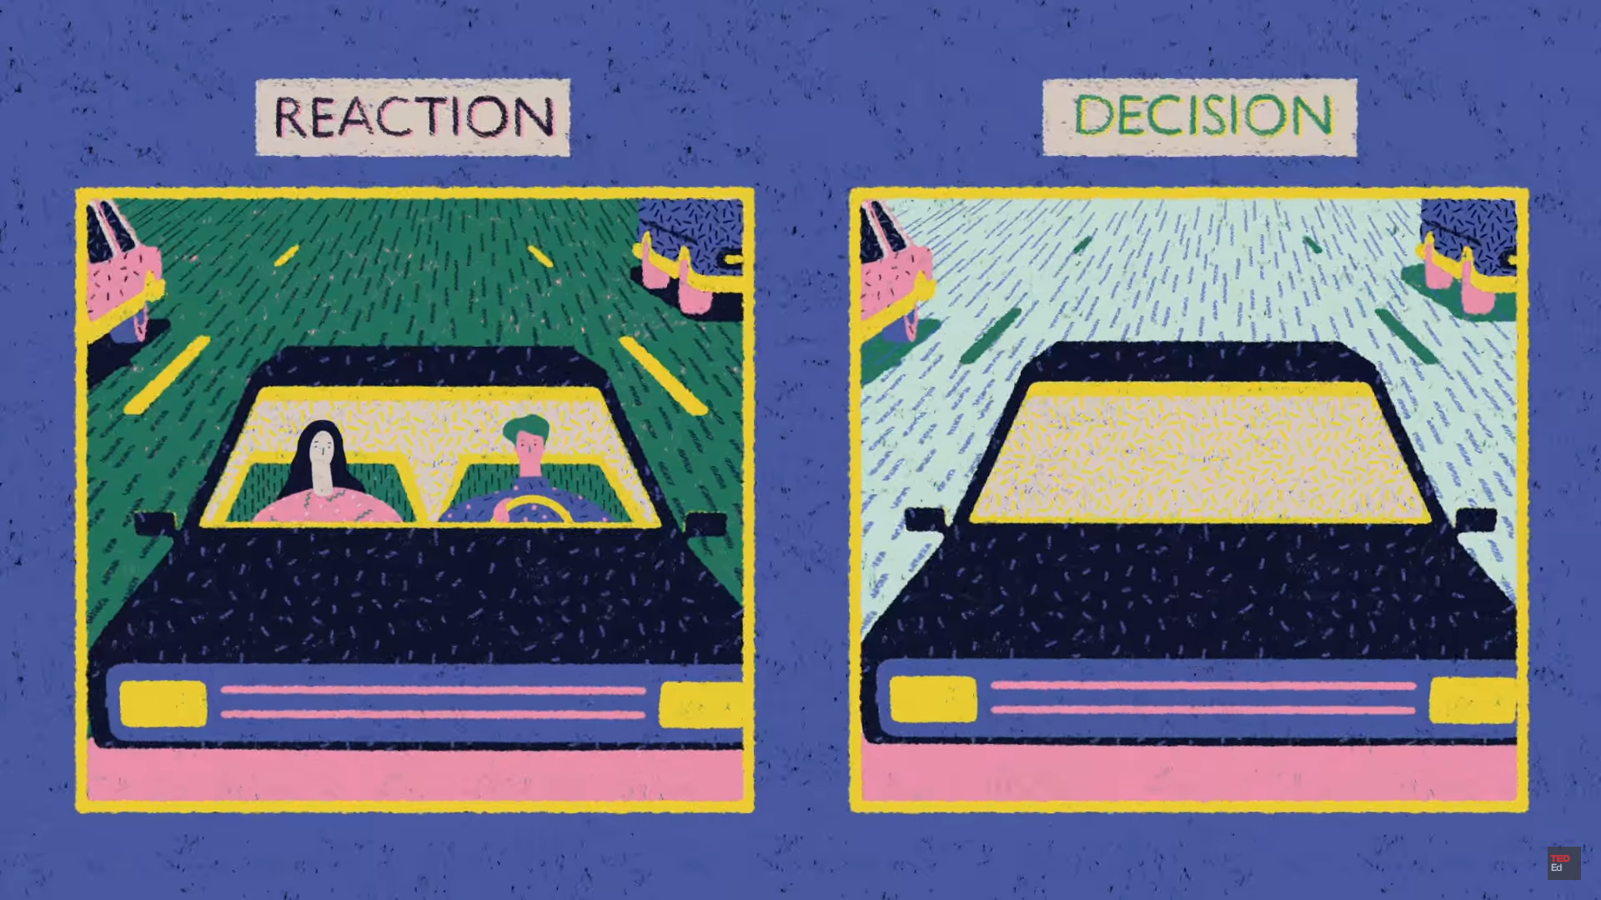
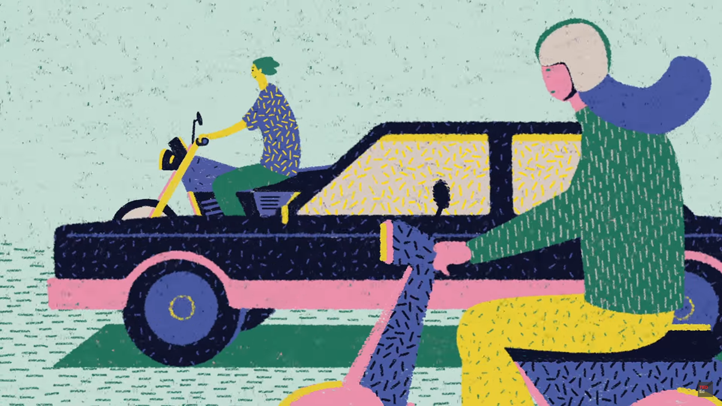
Moral choices of the AI

Slide 13



